Slide 1




DIGITAL LITERACY
SKILLS

Slide 2
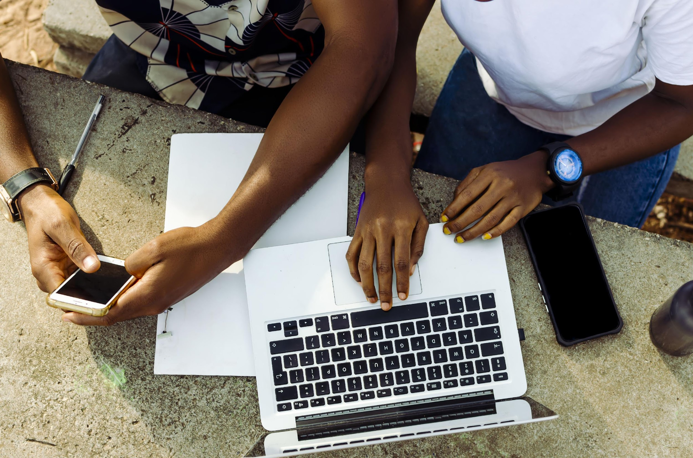
Module 1
Foundation digital skills

Slide 3

2
Unit 2: Basics of an internet-enabled mobile device

Slide 4
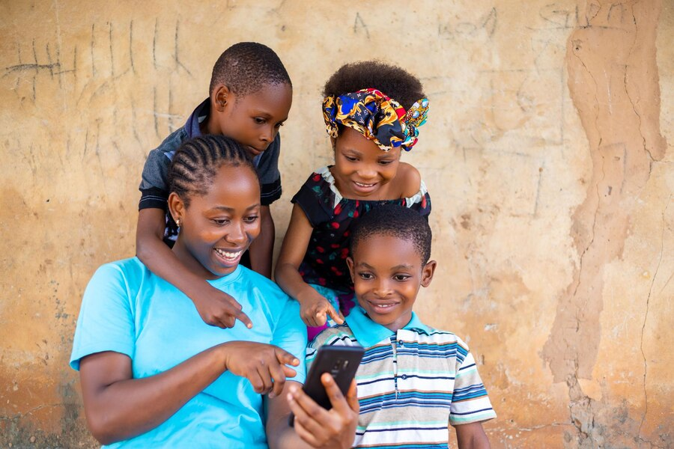
Mobile internet
There are two main ways that a mobile device can connect to the internet
Mobile network
Wi-Fi

Slide 5
Skills to practise
An internet-enabled mobile device can access the internet through mobile networks or Wi-Fi.
Make two lists with these headings:
Advantages of mobile network internet
Advantages of Wi-Fi internet.
Which type of access do you mostly use?

Slide 6
Smartphones and tablets
Functions
FUNCTION | TABLET | SMARTPHONE
Making and receiving calls | ✔ | ✔
Sending and receiving messages | ✔ | ✔
Connecting to the internet via cellular data, Wi-Fi or Bluetooth | ✔ | ✔
Downloading data from the internet | ✔ | ✔
Using apps specifically designed for the device | ✔ | ✔
Connecting additional accessories | ✔ | ✔

Slide 7
Skills to practise
Ask 10 members of your family or friends these questions:
Do you prefer a smartphone or a tablet?
Which one would you use for watching a movie?
Which one would you use for making a voice call?
Tally the numbers for each question.
Put your answers onto a spreadsheet that looks like this example alongside.
Question | Smartphone | Tablet
Do you prefer a smartphone or tablet?
Which one would you use for watching a movie?
Which one would you use for making a voice call?

Slide 8
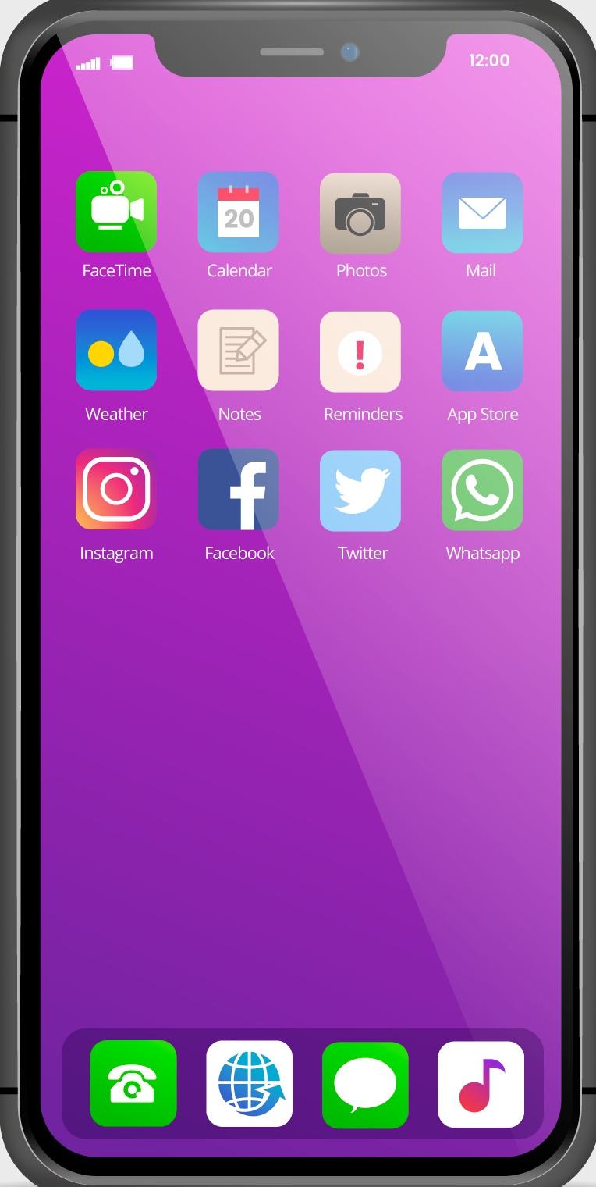
Apps
There are five main categories of apps.
Communications
Utilities
Productivity
Media
Games

Slide 9
Skills to practise
Browse the app store on your device.
Find an example of each category of app on the store that you would like to use.
Assess whether they are free, subscription, once-off or in-app purchase apps.
Download the apps that are free only.
Talk to a fellow learner and ask them about the apps that they have downloaded.

Slide 10
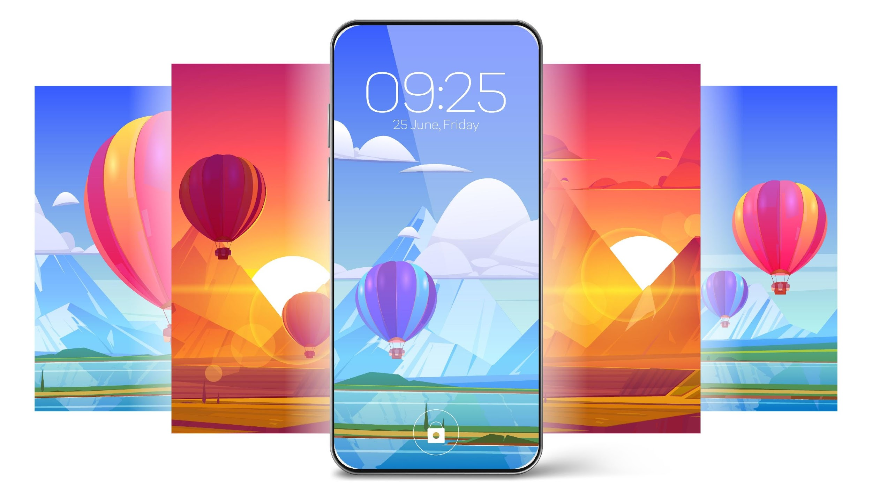
Settings
There are two main categories of settings:
Personalisation: Means making something meet an individual’s specific requirements.
Privacy and security: Privacy means having the ability to choose how much personal information is shared by apps, software, and device.

Slide 11
Skills to practise
Read the following statements and say whether they are true or false.
Type all the false sentences in a document to make them true.
STATEMENT | TRUE | FALSE
You can only change your lock screen to a picture you have uploaded.
The wallpaper one your device by default cannot be changed.
Notifications are made up of banners and badges.
A banner pops up on the screen with a summary of the notification.
A badge is the sound the device makes when it receives a notification
Most devices have pre-loaded ringtones to choose from.
Location services must be turned on for all apps and software.
The best password is a short one that is easy to remember like 12345.

Slide 12
All back covers should include
contact information of the section
producing the work.
© United Nations Children’s Fund (UNICEF) [month and year of publication]

